Slide 1
USSF Radiation Exposure Support for High-Altitude Aircrew
Jeff Cox Bryan Davis
Senior Project Leader Program Manager
SDA Sensors & Analytics SSC/SZGA
7 June 2024
Approved for Limited Distribution to NASA’s 11th Community Coordinated Model Center (CCMC) Workshop Attendees Only.
OTR-2024-00629

Slide 2
Overview
DoD radiation exposure (RadEx) requirements
Legacy capabilities
  High-Flyer Dose Map
  Radiation Exposure Warning
Partnering with NASA/CCMC
Space Domain Awareness (SDA) Environmental Toolkit for Defense (SET4D)
Summary and Way Ahead

Slide 3
DoD Radiation Exposure Requirements
AF Form 1067 Radiation Exposure (RadEx) Model Upgrade
  Detailed performance parameters documented in July 2016
  Needs for maps, warnings, and forecasts of radiation exposure
9th Operations Group Operating Instruction outlines procedures for the Beale Combat Weather Team (9 OSS/OSW) to monitor the High-Altitude Radiation Index (HARI)
  Condition YELLOW when HARI ≥ 3 mRems/hr
  Condition RED when HARI ≥ 10 mRems/hr
9 OG Operating
Instruction
Image credit: 9 OG OI 11-25
Image credit: 9 OG OI 11-25

Slide 4
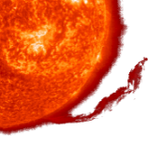
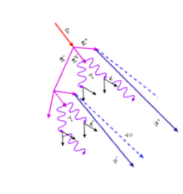


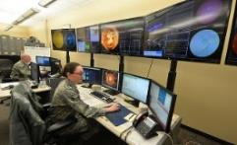
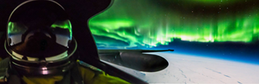

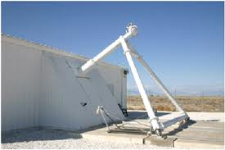
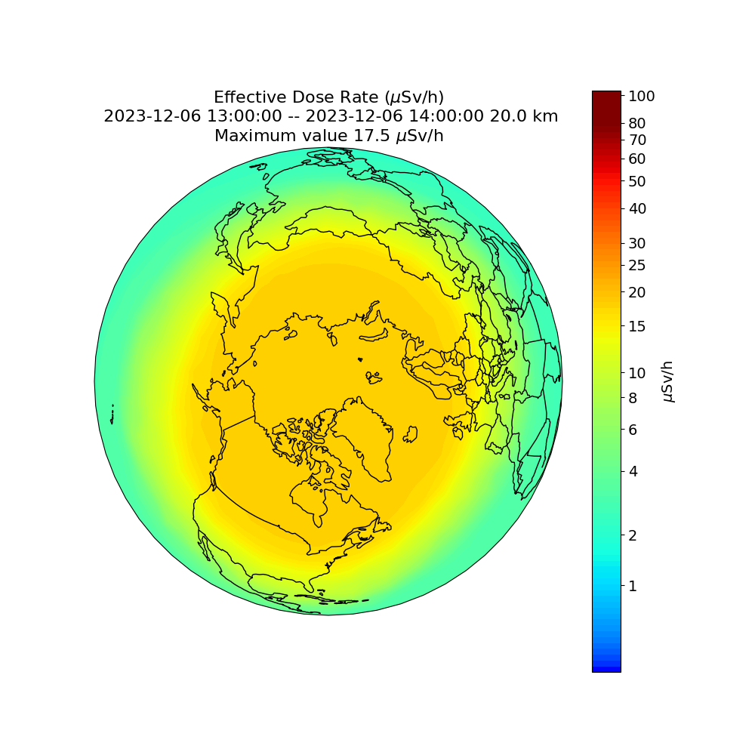

Operation View
Proliferated Sensors
Solar Energetic Particle (SEP) event
SpEnv Impacts on Platforms, Links & Warfighters
Research &
Commercial
Cascade from GCR and solar particles
cause radiation
Civil
DoD Space Weather Ops Center
ACC 2nd Weather Squadron
DoD
Allied
Reachback support
Head-up displays
Sensor data quality & model output monitoring
Transport Layer
SpEnv Displays
Automated Data Exploitation
U2 at 70,000 ft over Canada (Feb 2018)
SOON
Standard Data Records
SET4D on C2S Cloud
UNCLASS//SECRET//TOP-SECRET
Standard Interface
UDL
Dev sandbox
Data Repositories
SOON monitors solar flare locations, neutron
monitor data from Thule for galactic cosmic rays
and GOES proton fluxes to specify RadEx
Radiation Exposure maps and
warnings sent to 9th Ops Support Sq
Notes:
LtCol. Franquemont flies U2 at 70,000 ft over Canada below the aurora in Feb 2018

Slide 5
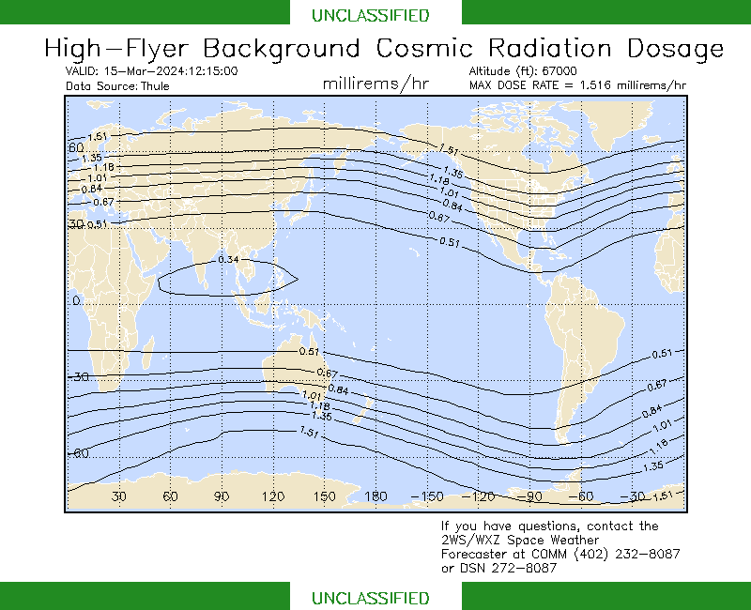
Legacy Radiation Exposure Capabilities (1 of 2)
Global Cosmic Ray Effective Dose
Global map shows background cosmic ray radiation at an altitude of 67,000 feet
  Neutron data measured at Pituffik Space Base, Greenland (formerly known as Thule) is used with FAA CARI-6 model
  Does not include SEP dosage
SWAFS is modernizing the Proton Prediction System (PPS) → SEP Forecast System (SFS) developed by AFRL (Dr. Stephen White)
  Predicts the likelihood of SEP events for 3-days
  After a flare, predicts the arrival time and intensity of the protons at >5, >10, >30, >50, >60, & >100 MeV
WARNING: A proton event is in progress. Actual doses may be much higher than indicated here. Contact 2WS/WXZ Forecaster for details.
SWAFS RadEx Dose at 20 km altitude (15-25 March 2024),
typical doses are 12-15 μSv/hr [Image credit: AFW-WEBS]

Slide 6
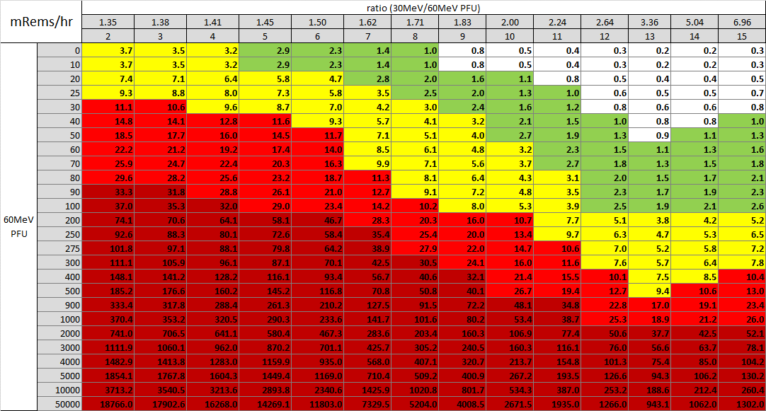
Legacy Radiation Exposure Capabilities (2 of 2)
Solar Energetic Particle Dose - Warning
The total radiation dose is a combination of GCR and solar energetic particles dose
  GCR dose is relatively low and stable
  SEP dose is episodic and varies in intensity
The Earth’s magnetic field has a rigidity cutoff that limits energetic particle access at low latitudes (polar cap region has easy access for these CGR and SEP particles)
The SEP dose depends on the intensity of the particle flux and the “hardness” for the SEP event
  Operationally, 2d Weather Squadron uses the ratio of >30 MeV protons to the >60 MeV protons to determine the hardness of the SEP event

Slide 7
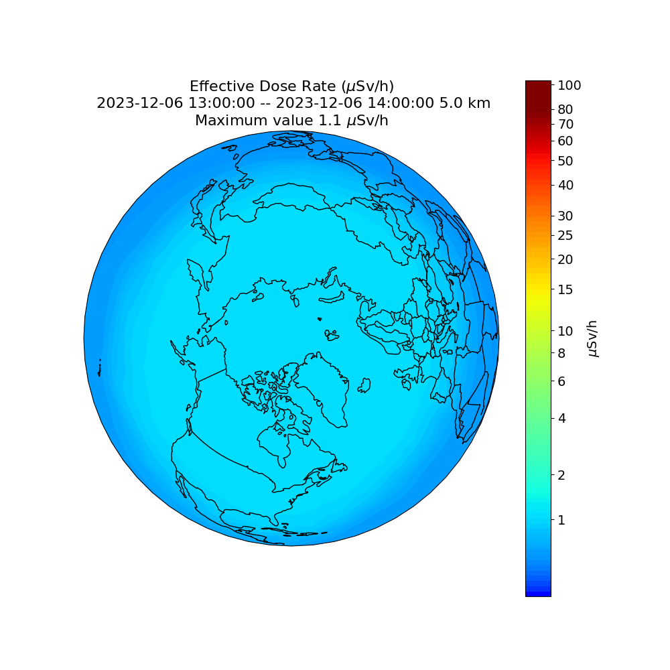
NASA/CCMC Partnering
DAF met with CCMC on 8 Jun 2023. Discussions identified opportunity for USSF to exploit the output of Nowcast of Atmospheric Ionizing Radiation for Aviation Safety (NAIRAS) model to support high altitude aircrew dose
  On 2 Nov 2023 at 14:00 UTC, the new 20 km altitude became operational!
Altitude makes a significant difference in radiation exposure with the maximum dose at 67,000 ft (~20 km)
  Known as the “Pfotzer maximum” and the operational aircrew dose maps are provided at this altitude of max dose
Maps of high latitude radiation dose rate from NASA’s NAIRAS model at 5 km and 20 km are shown to the right during quite solar activity
  Radiation dose increases with increasing altitude until you reach ~20 km
CGR dose is typically less than 1-2 mRem/hr (or 10-20 μSv/hr) at 20 km
NAIRAS data and maps show cumulative dose of galactic cosmic rays and solar energetic particles
5 km
20 km
Image credit: NASA/CCMC

Slide 8
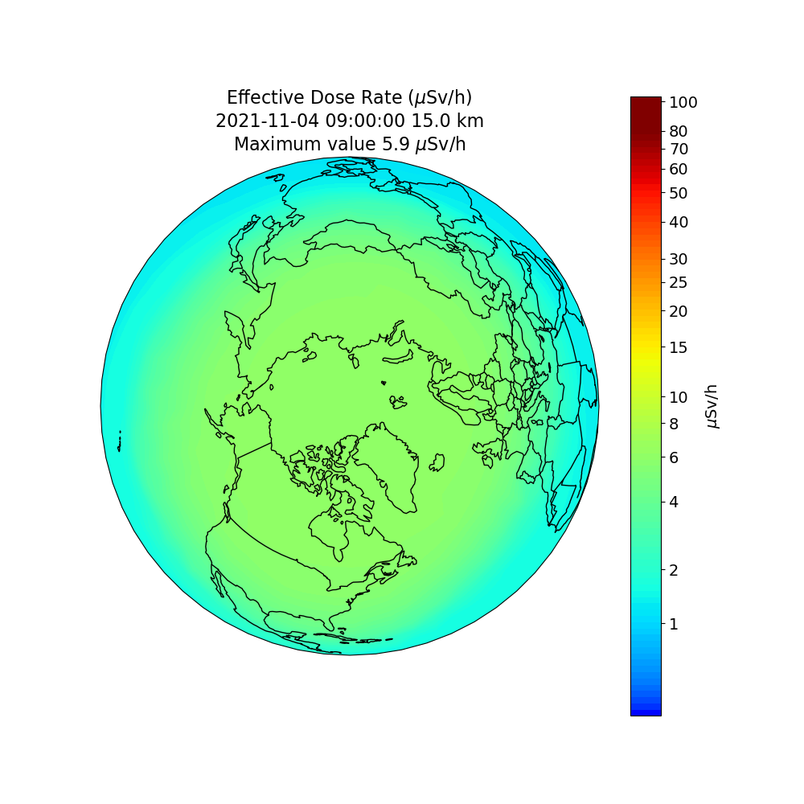
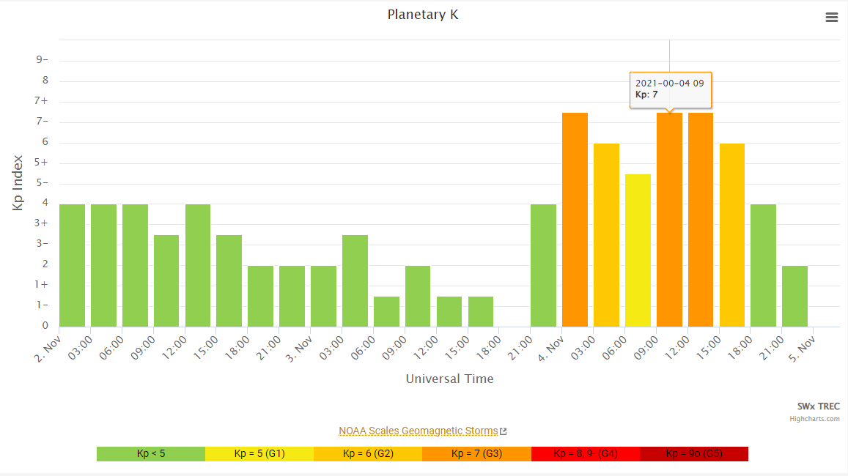
Why does it matter? Forbush Decrease
Forbush decrease is a rapid decrease in the observed galactic cosmic ray intensity following a coronal mass ejection (CME)
Image credit: CU Boulder/LASP SWx TREC
NAIRAS Effective Dose at 15 km altitude (3 Nov 2021),
typical doses are 10-15 μSv/hr [Image credit: NASA/CCMC]

Slide 9
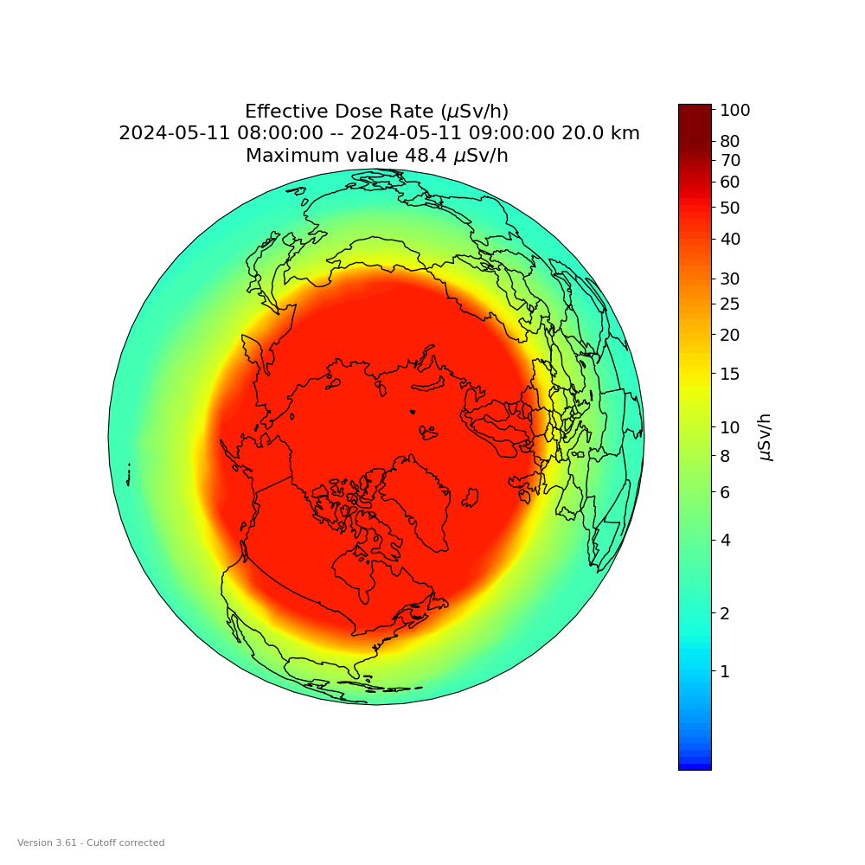
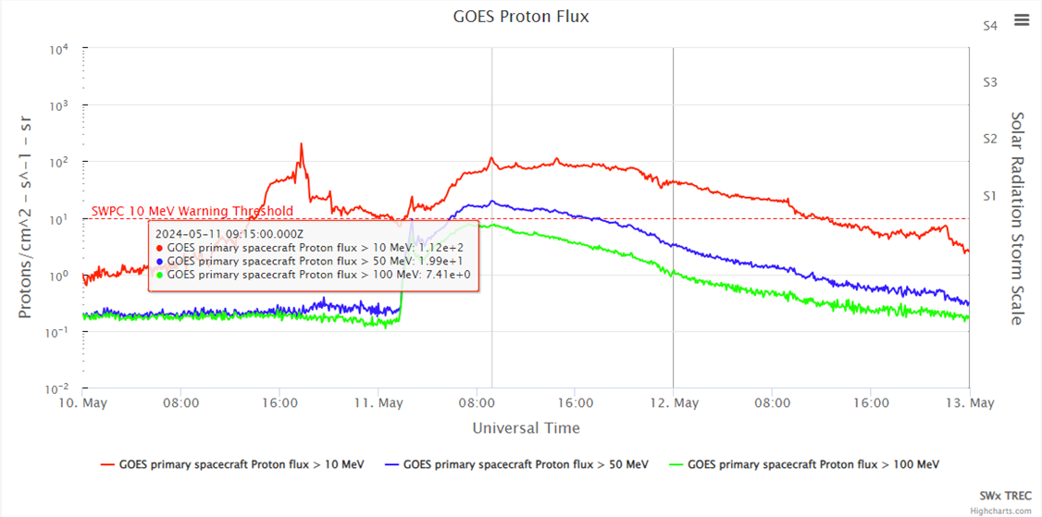
Why does it matter? SEP Increase
During strong solar flares, solar energetic particles are accelerated to near relativistic speeds and high energies (>10 MeV)
Largest SEP event since 20 km altitude dose maps were available was on 11 May 2024
  SEP event increased radiation dose to warning levels for U2:
  Red at high Latitudes and Yellow at mid Latitudes
19.9 pfu at >50 MeV
7.4 pfu at >100 MeV
NAIRAS Effective Dose at 20 km altitude (11 May 2024),
minor increase in radiation exposure
[Image credit: NASA/CCMC]
Image credit: CU Boulder/LASP SWx TREC

Slide 10
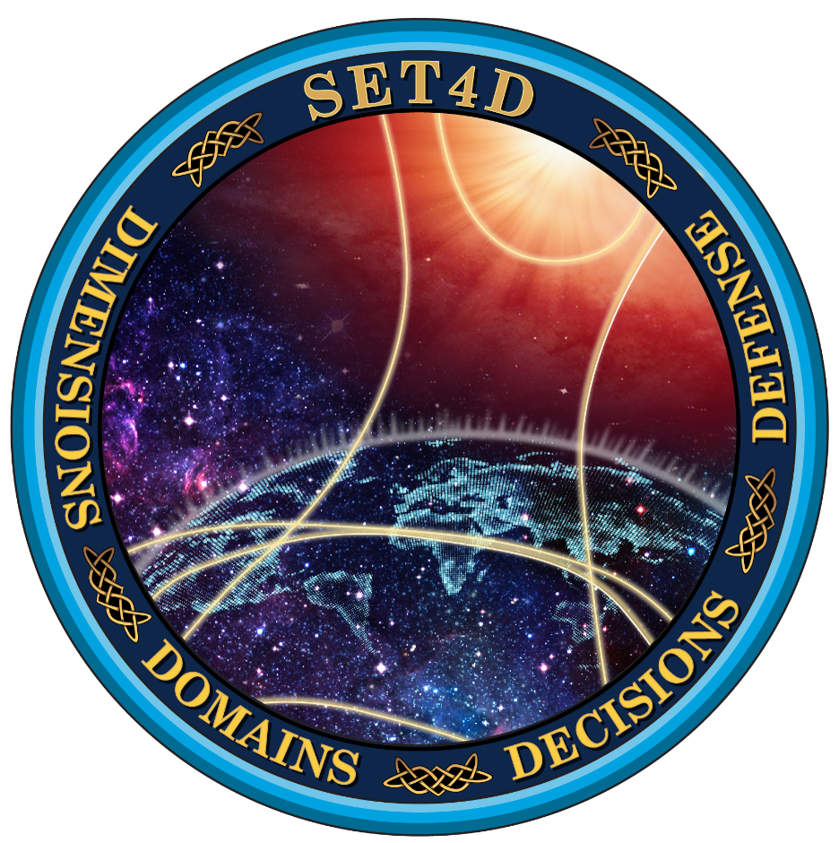
(U) SET4D Architecture
(U) Space Domain Awareness (SDA)
Environmental Toolkit for Defense (SET4D)
[Image credit: Peraton, Inc.]

Slide 11
What is SET4D?
Project under the Space Weather Analysis and Forecast System (SWAFS)
Space Domain Awareness (SDA) Environmental Toolkit for Defense (SET4D)
  Mission: Exploit space environmental data to characterize and forecast impacts to operations, communications, and systems for national defense
  Vision: Provide space environment exploitation for today and tomorrow’s threats
The Dec 2023 Implementation Plan of the National Space Weather Strategy and Action Plan top objective:
  Enhance the Protection of National Security, Homeland Security, and Commercial Assets and Operations against the Effects of Space Weather… SET4D is the answer to this need!
What is SET4D?
Analytics to exploit space environment and weather observations to provide tailored impacts directly to warfighters
Software suite on highly reliable & available GovCloud architecture
Attribution, monitor and forecast of environmental hazards
Toolkit to determine operationally relevant space weather impacts
What SET4D isn’t?
A database of space environment & weather observations (UDL)
A sensor or sensing program to collect space environment & weather observations (IGS-NEXION/ISTO, SEON-SOON/RSTN, ECP, COSMIC2)
R&D program to mature or develop space weather capabilities
Scientifically interesting space weather display or data

Slide 12
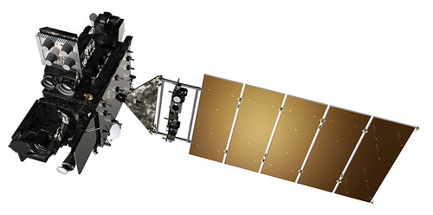
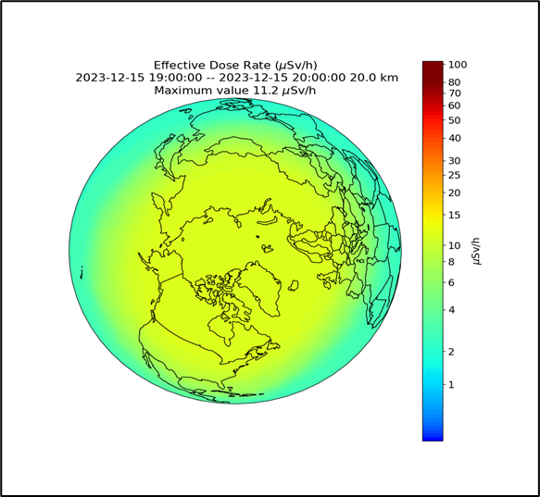

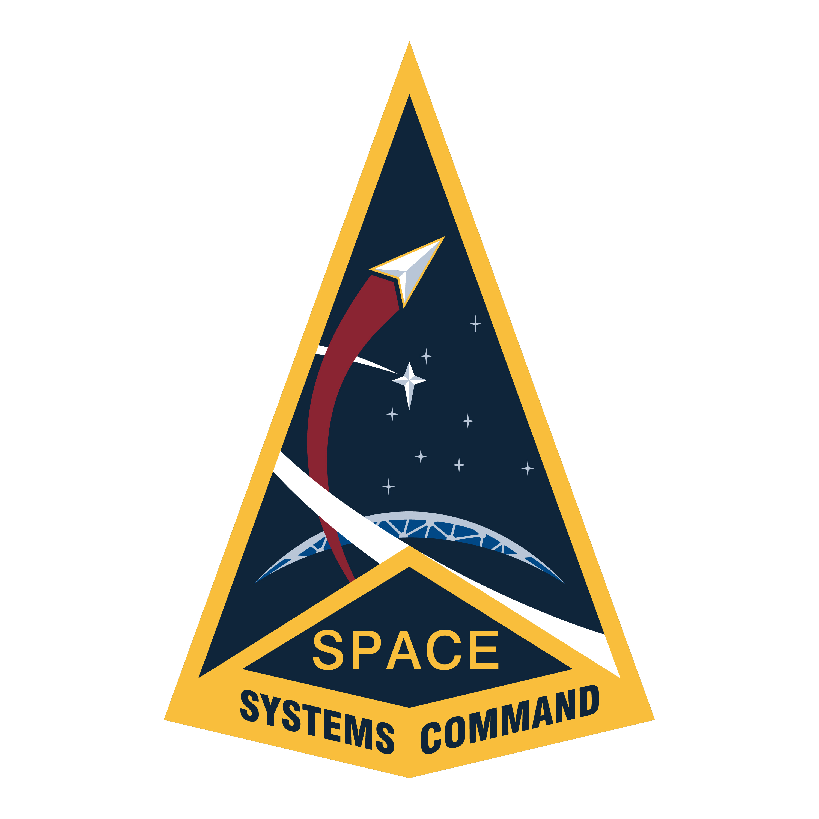
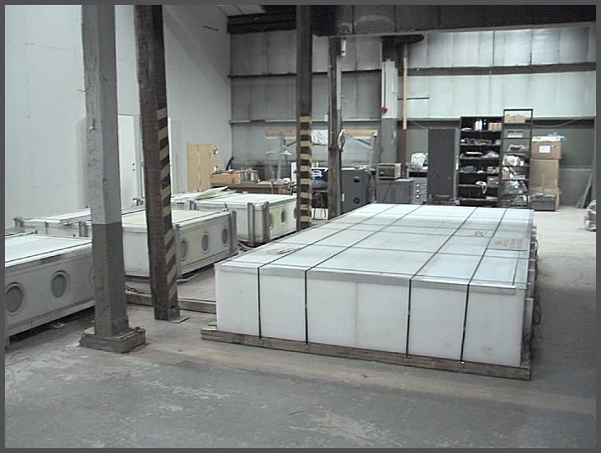
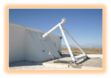
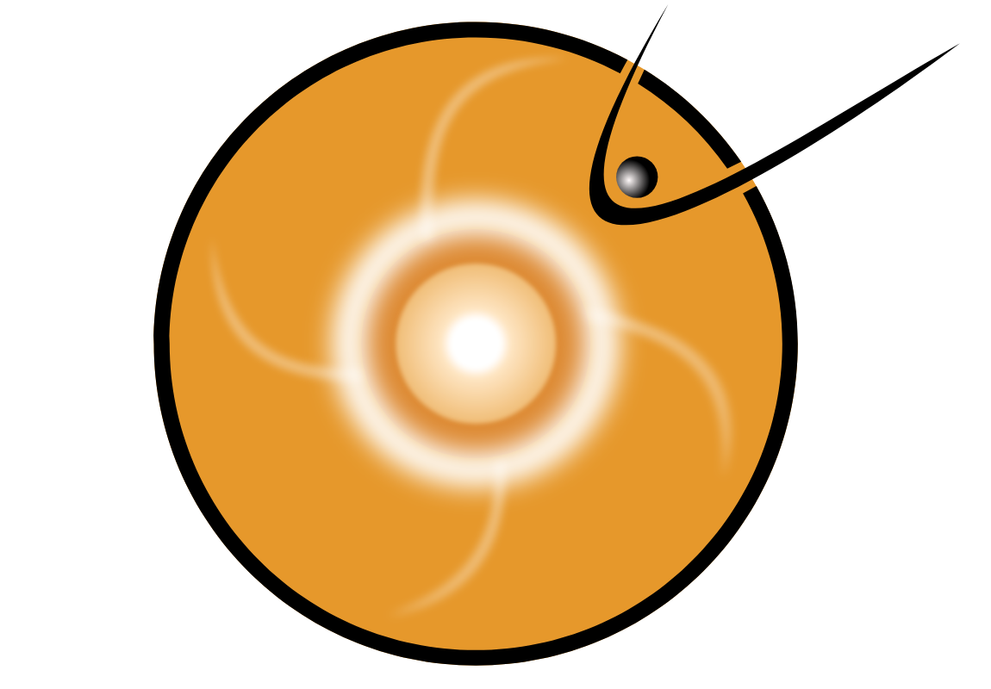
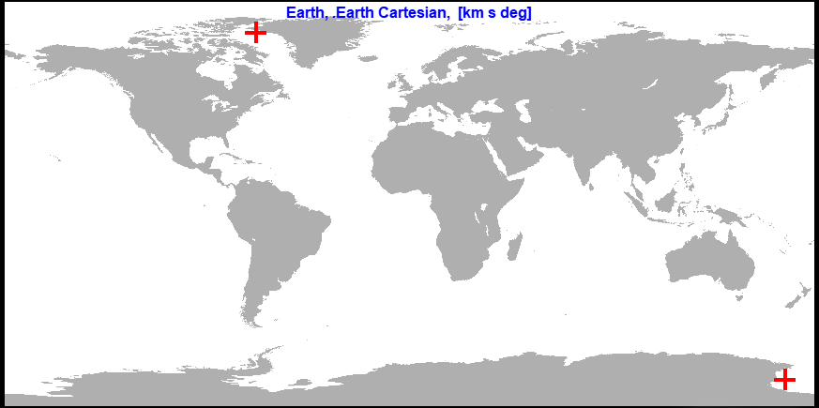
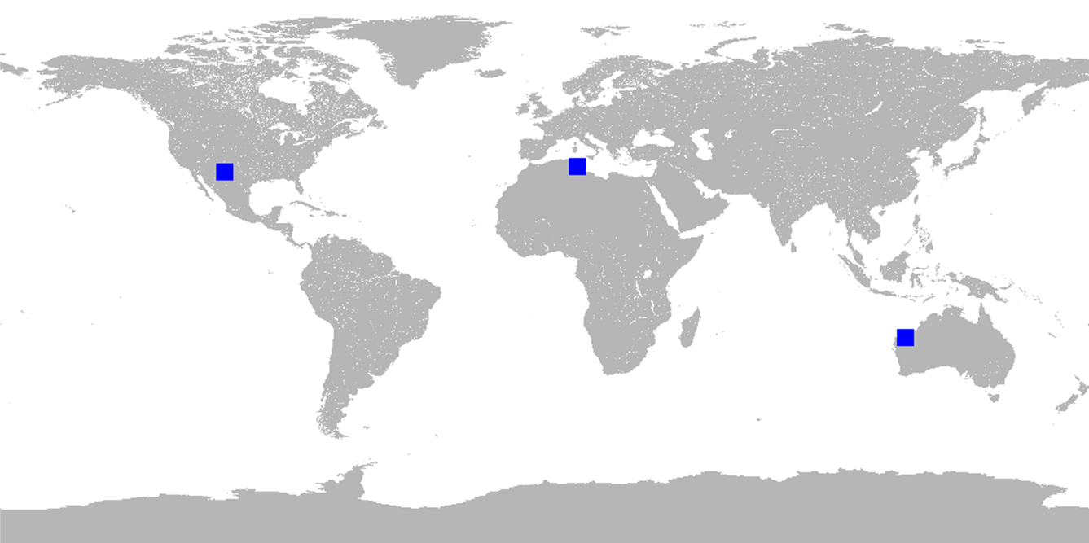
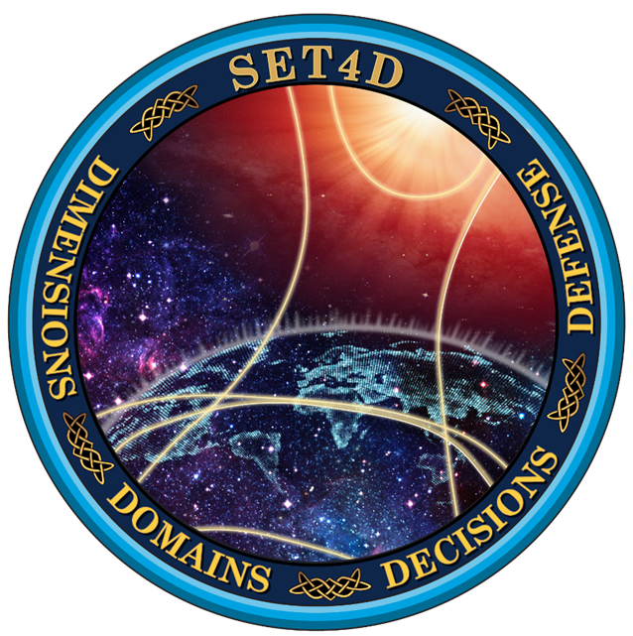
SET4D RadEx Architecture
GEO
[Image credits: NASA/CCMC; NOAA/NESDIS; Univ of Delaware; 2d Weather Squadron; Peraton, Inc. ]
GOES (2x)
Radiation Exposure Maps
SEISS/EXIS
UDL
SpEnv EDRs
GOES RadEx
Radiation Exposure Warnings
SEP Forecast System (SFS)
Neutron
Monitor
SOON
H-α flare location
NAIRAS
NASA/CCMC
2x
3x
NIPRNET
SET4D
Model/Algorithm
SET4D
Micro-service
SET4D/UDL
Storage
Product
SIPRNET JWICS

Slide 13
Summary and Way Ahead
SWAFS/SET4D ingest and display of NAIRAS gridded data at 20 km (2D at ~Pfotzer maximum)
Modernized radiation exposure warning based off NAIRAS effective dose
  Potential for regional warnings for different Tactical ISR units
3D NAIRAS gridded output with flight route application to calculate dose along the flight route, including USTRANSCOM cargo altitudes
Forecast RadEx Warnings (avoid the exposure to aircrew by alerting operations team prior to exposure!)
  Leverage SFS to predict likelihood for SEP events multiple days into the future
  UMASEP-NAIRAS coupling for observed SEP events

Slide 14
Questions?
UNCLASSIFIED – Limited Distribution (CCMC Workshop)

Slide 15
Back-up

Slide 16
(U) SET4D Paradigm Shift from Legacy SWAFS
SET4D is focused on impacts vs. environment
SET4D is direct to operators vs. web pull
SET4D is tailored to specific operational systems, locations, frequencies, and geometry vs. generic global characterizations
SET4D provides awareness/assessments on-demand vs. on a scheduled
2 WS will be “over-the-loop” reach-back subject matter expertise vs. “in-the-loop” for product production
SET4D is primarily data-driven impacts vs. model-driven
SET4D uses a comprehensive data/attribution archive vs. data stored for 30 days
SET4D uses an open architecture designed for component reuse and rapid R2O vs. monolithic codebase with duplication, black boxes, and stovepipes
SET4D includes weather impacts on space systems/services vs. space weather only
SET4D impact products are primarily available on SIPRnet/JWICS vs. mostly on NIPRnet with some SIPRnet (no JWICS processing)
SET4D forecasts can be probabilistic vs. all deterministic with unknown or large errors
Notes:
SET4D is direct to operators vs. web pull
Operators and decision makers (and M2M) log into SET4D and have access to customized impact information. User information from CAC card (NIPRnet) and PKI certificates (SIPRnet and JWICS) provides customized user experience… satellite operator get ECP-HAS capabilities, while PNT users get GPS scintillation impacts. Today, everyone gets everything.
SET4D is focused on impacts vs. environment
Operators and decision makers want to know operationally relevant information and not scientifically interesting space weather. Products and services are put in operational terms, e.g. signal fade in dB for a shortwave fade vs. X-ray flux intensity of a solar flare.
SET4D is tailored to specific operational systems, locations, frequencies, and geometry vs. generic global characterizations
The number one feedback provided from USSF operators during visits and coordination is, “I need to know how space weather impacts my mission.” The legacy space weather conditions from SWAFS require the user to interpret the science. SET4D puts the impacts in operational terms, e.g. dB of signal fade, satellite charging, radar clutter, etc.
SET4D provides awareness/assessments on-demand vs. on a scheduled basis… every hour, on-the-hour
The on-demand architecture allows SET4D to take advantage of more data by waiting until an operator requests an attribution to generate a product (more latent data arrives). The on-demand architecture maximizes the processing power of the cloud to focus on the tailored impacts, while saving resources by only providing impacts when and where needed.
2 WS will be “over-the-loop” reach-back subject matter expertise vs. “in-the-loop” for product production
Today’s Space Weather Operation Center in 2 WS spends the majority of their time making space weather awareness products. These will be automated in SET4D, allowing the 24/7 crew to focus on customer service and consultation to ensure operators understand the environmental impacts.
SET4D is primarily data-driven vs. model-driven
SET4D attribution capabilities primarily exploit observations to make assessments on impacts. SET4D will bring attribution capabilities (not available in SWAFS) into operations for satellite anomalies, EMI, and Launch and Predicted Impacts (L&PI). More data, including commercial data, are planned for ingestion into SET4D to provide coverage and refresh needed for characterizing the impacts of the environment on space operations and services, allowing less reliance on inaccurate empirical models of “average” conditions. For example; USNDS and REACH charged particle data will provide coverage for LEO and MEO satellites not available in SWAFS. Another example; GPS RO measurements of scintillation with a new algorithm for geo-location will provide All Clear Maps and Bubble Maps for SATCOM and PNT not available in SWAFS.
SET4D uses a comprehensive data archive vs. data only stored for 30 days
Saving the weather and space environment observations for long periods of time enables data science applications for artificial intelligence and machine learning to be brought to bear on tough physics problems. Additionally, deep dive investigations of impacts can compare environmental conditions since the system has been operational.
SET4D uses an open architecture designed for component reuse and rapid R2O vs. monolithic codebase with duplication, black boxes, and stovepipes
Eliminating duplication and breaking the software functions into the small sub-component makes sustainment and cloud scalability easier. When new versions of models and applications become available, SET4D only needs to replace the outdated functionality once. Today’s black boxes have unknown technical debt and cyber vulnerabilities.
SET4D includes weather impacts on space systems and services vs. space weather only
Any environmental impact (i.e. both weather and space weather) on space operations or services is part of SET4D, including rain attenuation of trans-ionospheric signals, cloud and aerosol impacts on EO/IR SDA and missile warning sensing, anomalous propagation (ducting) of radar signals, and optical turbulence from temperature gradients and winds. These tailored weather impacts are not available from Air Force Weather forecasters.
SET4D is primarily available on SIPRnet/JWICS vs. mostly on NIPRnet with some SIPRnet
As SET4D is focused on system impacts at a specific time, location, and geometry; there are OPSEC and system vulnerability information provided by SET4D that is typically classified. Since SWAFS focuses on environmental characterization most of the products are “weather” maps or dashboards and UNCLASSIFIED.
SET4D forecasts are probabilistic vs. deterministic
Legacy space weather models attempt to forecast the specific future conditions but have large errors. SET4D will make most of the forecasts in a probabilistic way; providing the likelihood that an impacting environment will occur. These probabilistic forecasts can be exploited by decision makers by fusing all the potential risks to the planned mission.

